Slide 1
Fidelity Investments
Virtual Benefits Fair

Slide 2
Click play to watch the video

Slide 3
Key Plan Features
Enrollment | There is no waiting period. You can enroll in the Plan at any time.
Contributions | Through automatic payroll deduction, you may contribute up to 100% of your eligible contributions.
Investment Options | To help you meet your investment goals, the Plan offers you a range of options. You can select a mix of investment options that best suits your goals, time horizon, and risk tolerance. The many investment options available through the Plan include conservative, moderately conservative, and aggressive funds.
What is my tax bracket now, and what is it expected to be in retirement?
How long is my retirement horizon?
Am I eligible to contribute to a Roth IRA?
This workshop provides only a summary of the main features of the Plan, and the Plan document will govern in the event of any discrepancies.
Notes:
Enrollment
There is no waiting period. You can enroll in the Plan at any time. One thing to note - If you have not enrolled in the Plan within 30 days from your date of hire, you will be automatically enrolled in the Plan at a contribution rate of 3% of your pretax eligible earnings. Your contributions will be invested in a T. Rowe Price Retirement Fund Class I. However, we encourage you to take an active role in the Plan and to choose a contribution rate and investment options that are appropriate for you. If you do not wish to contribute to the Plan, you must change your contribution rate to 0% within the first 30 days of your date of hire.
Contributions
Through automatic payroll deduction, you may contribute between 1% and 90% of your eligible contributions. The IRS contribution limit for 2024 is $23,000. If you have reached age 50 or will reach 50 during the calendar year January 1 – December 31 and are making the maximum plan or IRS contribution, you may make an additional catch-up contribution each pay period. The maximum annual catch-up contribution is $7,500. Going forward, catch-up contribution limits will be subject to cost of living adjustments (COLAs) in $500 increments. We will discuss the different contribution types further in the presentation.
Annual Increase Program
In addition, you can automatically increase your retirement savings plan contributions each year through the Annual Increase Program. Sign up online by accessing the “Contribution Amount” section on NetBenefits®, or by calling the Fidelity Retirement Service Center at 800-343-0860.

Slide 4
Key Plan Features (cont.)
Vesting | You are always 100% vested in your own contributions to the State of Rhode Island.
Online Beneficiary Designation | If you have not already selected your beneficiaries, or if you have experienced a life-changing event such as a marriage, divorce, birth of a child, or a death in the family, it’s time to consider your beneficiary designations.
One-on-One Consultations | Fidelity Workplace Financial Consultants are licensed professionals and can help with enrollment, asset allocation, retirement planning and other questions you have about the plan. Call 800-642-7131 weekdays from 8 a.m. to 9 p.m. ET to speak with a consultant or schedule a complimentary appointment. You can also schedule appointments online at fidelity.com/schedule.
What is my tax bracket now, and what is it expected to be in retirement?
How long is my retirement horizon?
This workshop provides only a summary of the main features of the Plan, and the Plan document will govern in the event of any discrepancies.
Notes:
Enrollment
There is no waiting period. You can enroll in the Plan at any time. One thing to note - If you have not enrolled in the Plan within 30 days from your date of hire, you will be automatically enrolled in the Plan at a contribution rate of 3% of your pretax eligible earnings. Your contributions will be invested in a T. Rowe Price Retirement Fund Class I. However, we encourage you to take an active role in the Plan and to choose a contribution rate and investment options that are appropriate for you. If you do not wish to contribute to the Plan, you must change your contribution rate to 0% within the first 30 days of your date of hire.
Contributions
Through automatic payroll deduction, you may contribute between 1% and 90% of your eligible contributions. The IRS contribution limit for 2024 is $23,000. If you have reached age 50 or will reach 50 during the calendar year January 1 – December 31 and are making the maximum plan or IRS contribution, you may make an additional catch-up contribution each pay period. The maximum annual catch-up contribution is $7,500. Going forward, catch-up contribution limits will be subject to cost of living adjustments (COLAs) in $500 increments. We will discuss the different contribution types further in the presentation.
Annual Increase Program
In addition, you can automatically increase your retirement savings plan contributions each year through the Annual Increase Program. Sign up online by accessing the “Contribution Amount” section on NetBenefits®, or by calling the Fidelity Retirement Service Center at 800-343-0860.

Slide 5
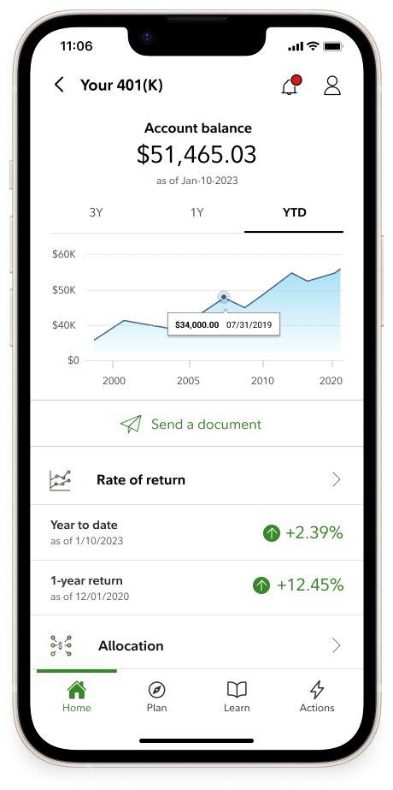
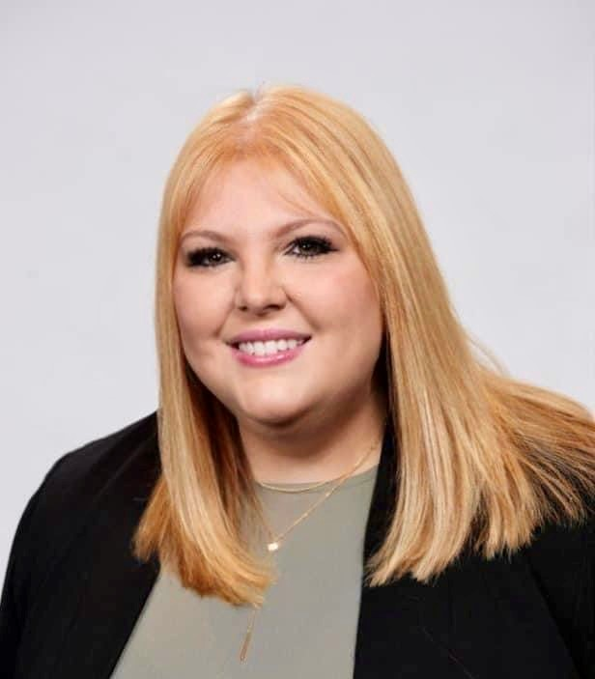
Tools & Resources
Financial Wellness
Financial Wellness Checkup See where you stand and how you can take simple steps to gain more control of today’s financial challenges.
Student Debt
Take control of your student loans Explore different repayment strategies using your real loan information to see if there’s a better way to pay off your loans for good.
Budget and Debt Digital Resources
Article: 7 Steps to Learn How to Budget Article: Pay Down Debt or Invest? How You Money: Who’s a beneficiary and why do you need one?
Saving and Spending
Power of Small Amounts See how a small change—1%, 3%, or 5%— can make a big difference.
Savings and Spending Checkup See how your savings and spending compare.
457(b) Contribution Calculator Helps you determine the maximum contribution to your 457(b) plan.
Retirement Income Calculator Explore ways to see how much money you could have every month, using a mix of predictable income and savings.
Attend a Workshop
 |  | Join Fidelity for an educational workshop, where you'll learn strategies and tips to help you manage your financial future with confidence.
NetBenefits.Fidelity.com/livewebmeetings Learn more about your workplace retirement savings plan at your convenience through on-demand, self-paced learning modules that provide financial education on a variety of topics, including:
 | Budget and debt management Saving for multiple goals | ➢ Budget and debt management ➢ Saving for multiple goals | Understanding your spending Creating a rainy-day fund
 | Managing unexpected events and expenses | ➢ Managing unexpected events and expenses
 | Log on to netbenefits.fidelity.com/ondemandmeetings to learn more. | Log in to netbenefits.fidelity.com/ondemandmeetings to learn more.
Download the NetBenefits Mobile App | Download the NetBenefits mobile App
 | Prefer a mobile experience?​ You can also download the NetBenefits® smartphone app for on-the-go access to your Fidelity workplace accounts.​ Download the NetBenefits® app today for an Apple, Android, or Amazon device.​ | Prefer a mobile experience?​ You can also download the NetBenefits® smartphone app for on-the-go access to your Fidelity workplace accounts.​ Download the NetBenefits® app today for an Apple, Android, or Amazon device.​ ​
Prefer to speak with someone?
Schedule a complimentary consultation with your dedicated Fidelity Workplace Financial Consultant, Ashley Bove. Go to fidelity.com/schedule, call 800.642.7131 or text TALK to 343898.​
September 17, 2024

Slide 6
Learn More
Meet
Call
Log in
Schedule a one-on-one consultation with a Fidelity Workplace Financial Consultant
Visit Fidelity’s dedicated site for State of Rhode Island employees
Call 800-343-0860 to speak to a Fidelity representative

